Slide 1
Notes:
Visit the PowerPoint resources page Backstage for quick tips and slide layout solutions for your presentations.

Slide 2
The Current State And Future Of Voice Search
Collin Colburn, Analyst
  June 14, 2019

Slide 3
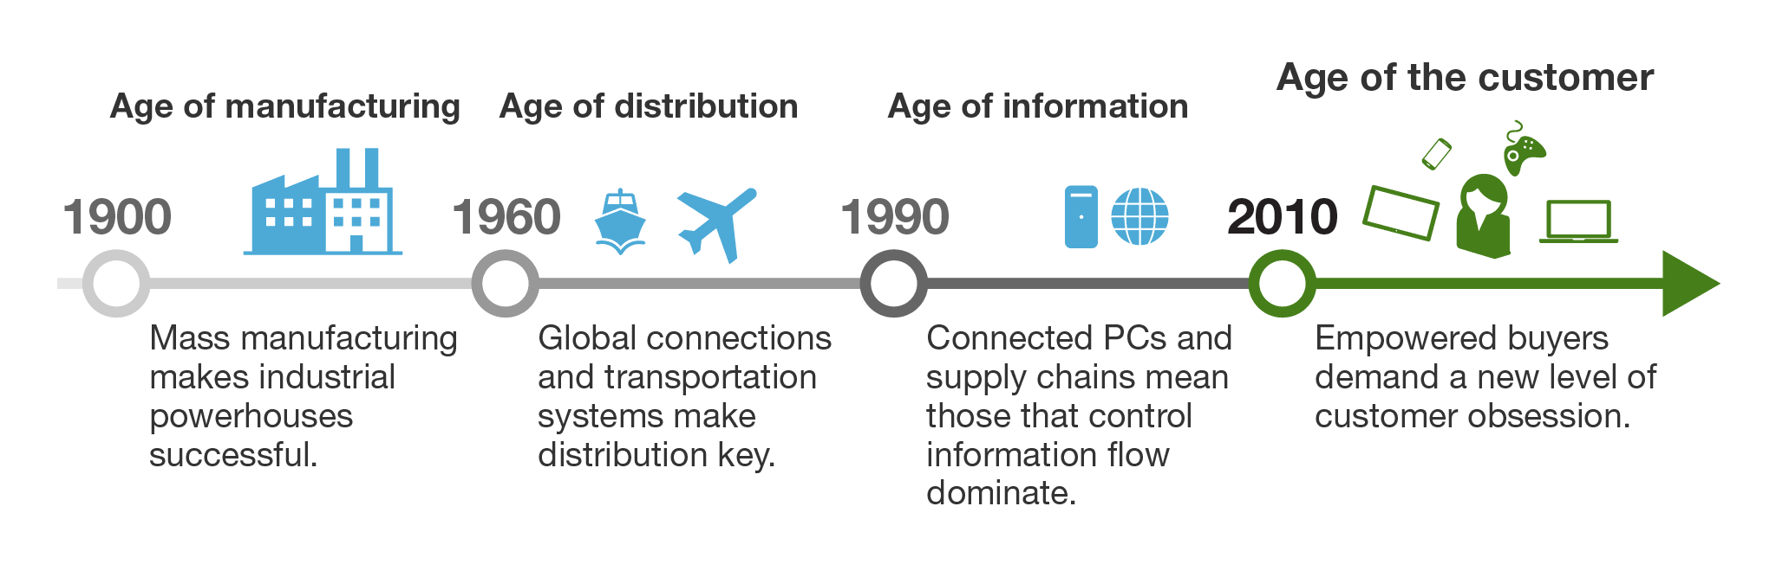
Welcome to the Age of the Customer
Source: Forrester Report “Winning In The Age Of The Customer”
Notes:
Businesses go through cycles. There are distinct ages that have happened over the past 100 plus years.
Before 2010, companies succeeded with manufacturing strength, distribution prowess, or information mastery. You can see that illustrated in the graphic here.
Since 2010, what’s changed? Simply put: companies need to have a relentless focus on customers in order to succeed in this new era. Disruptors who have a laser focus on their customers and providing the best experience to them are changing market dynamics, they are creating new industries, and are forcing companies to revaluate their business strategies.
So, that’s what’s going on from a macro business perspective. Specifically to marketing, I want to talk about how customers have changed their finding and searching behaviors over that same period…

Slide 4

Source: Getty Images
Notes:
During the age of manufacturing and into the age of distribution, libraries, newspapers, and personal connections(or the encyclopedia Britannica) were the primary ways that customers found new information, new products, and new brands.

Slide 5
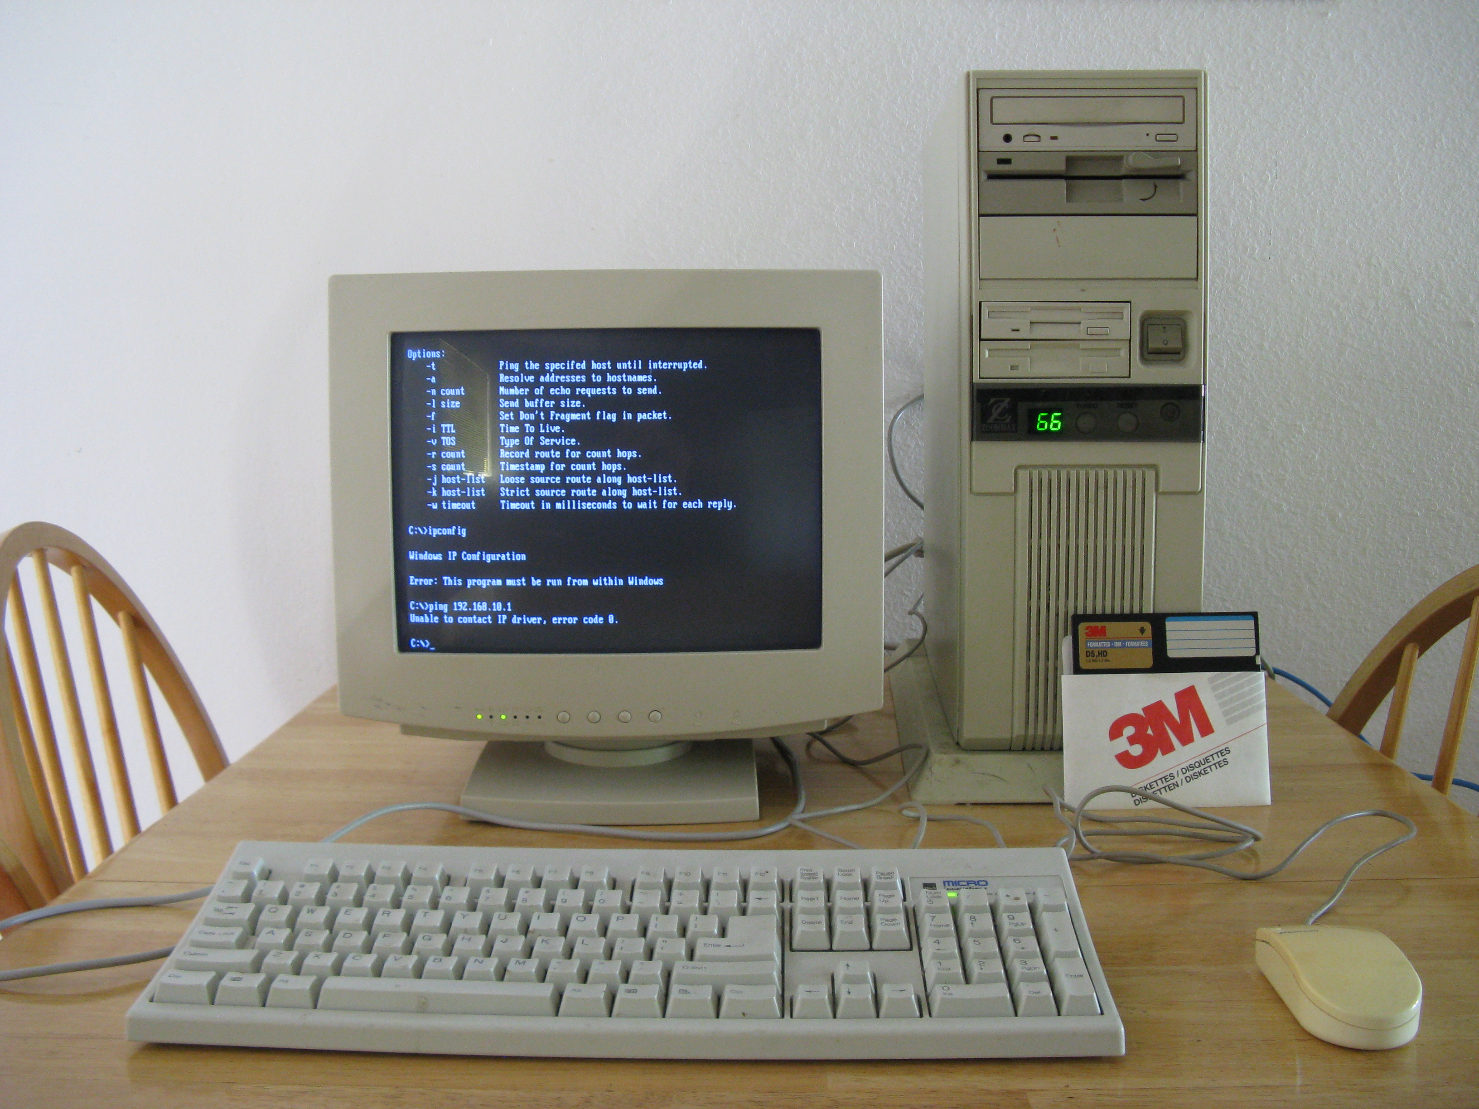
Notes:
In the age of information, computers became the primary resource for finding information – and during the 1990s, search engines began to dominate.

Slide 6
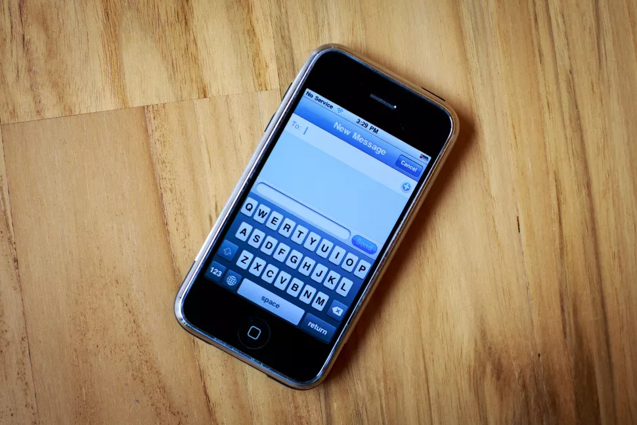
Notes:
Mobile devices began rolling out en masse in the 1990s, but it was the iPhone in 2007 that revolutionized, and was a contributor in spurring the Age of the Customer.
In fact, it is mobile devices that have helped shift power from businesses and institutions to the customer. The customer can get information whenever they want, they can do price comparisons, they can use it in a store, in a car, anywhere…

Slide 7
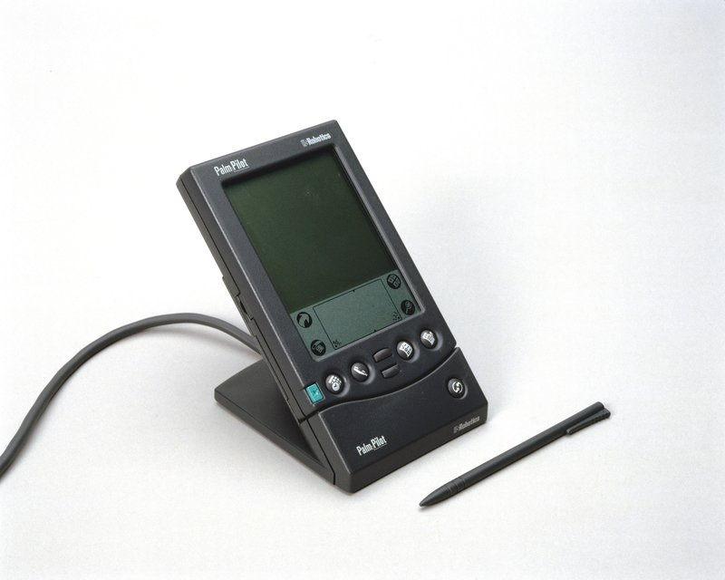
Notes:
But along this evolution there have also been losers in new forms of technology: the palm pilot

Slide 8
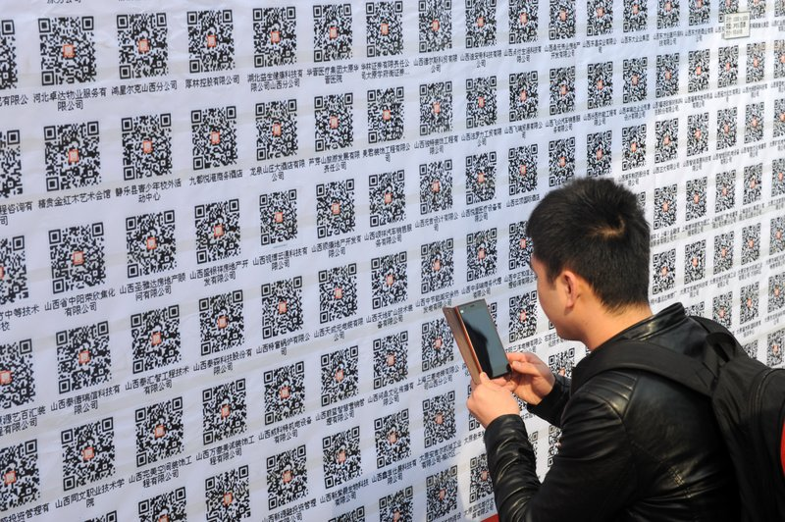
Notes:
Outside of Asia, QR codes never stuck

Slide 9
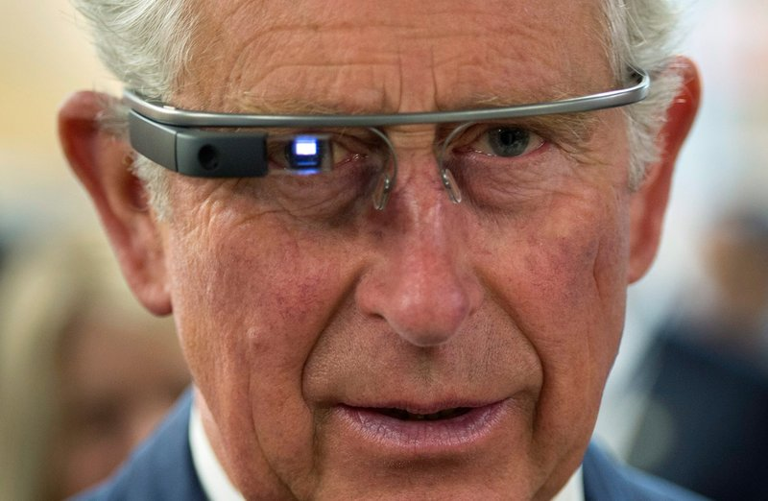
Notes:
And Google Glass just never…looked very good on most people.

Slide 10
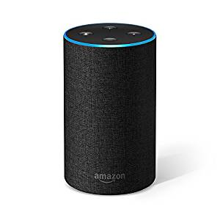
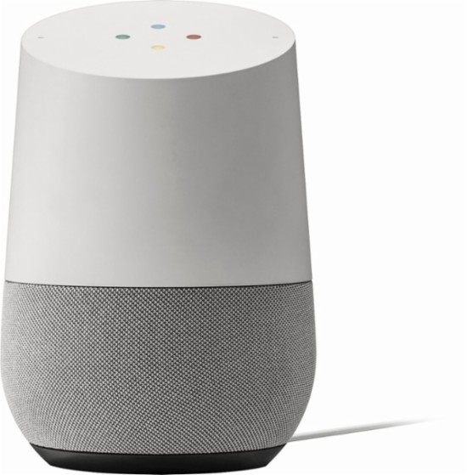
Notes:
But now there is a new piece of consumer technology that has hit the market with hype – voice assistants (or as we call them, Intelligent Agents) like Alexa and Google Assistant.
The jury is still out though on whether voice assistants will go the way of Google Glass, or be just as impactful (if not more impactful) than the iPhone was in 2007…

Slide 11

The jury is still out on what road IAs will take

Slide 12
The most savvy consumers use digital assistants
Base: 4.619 US online adults
Note: Totals may not equal 100%, respondents could select multiple choices
Source: Consumer Technographics North American Technology, Media, and Telecom Recontact Survey 2, 2018

Slide 13
Overall, Siri is the most highly adopted IA
Base: 4.619 US online adults
Note: Not all responses are shown, responses may not total 100%
Source: Consumer Technographics North American Technology, Media, and Telecom Recontact Survey 2, 2018

Slide 14
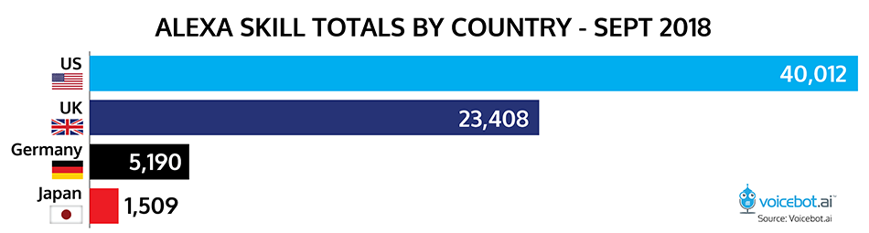
As a result, many sectors – including publishing – are preparing for a voice search future

Slide 15
But people don’t use their IA in very sophisticated ways yet
Base 751 US online adults (18+) that use a voice assistant speaker
Source: Forrester’s Consumer Technographics Consumer Technology, Media, and Telecom Recontact Survey 2, 2018

Slide 16
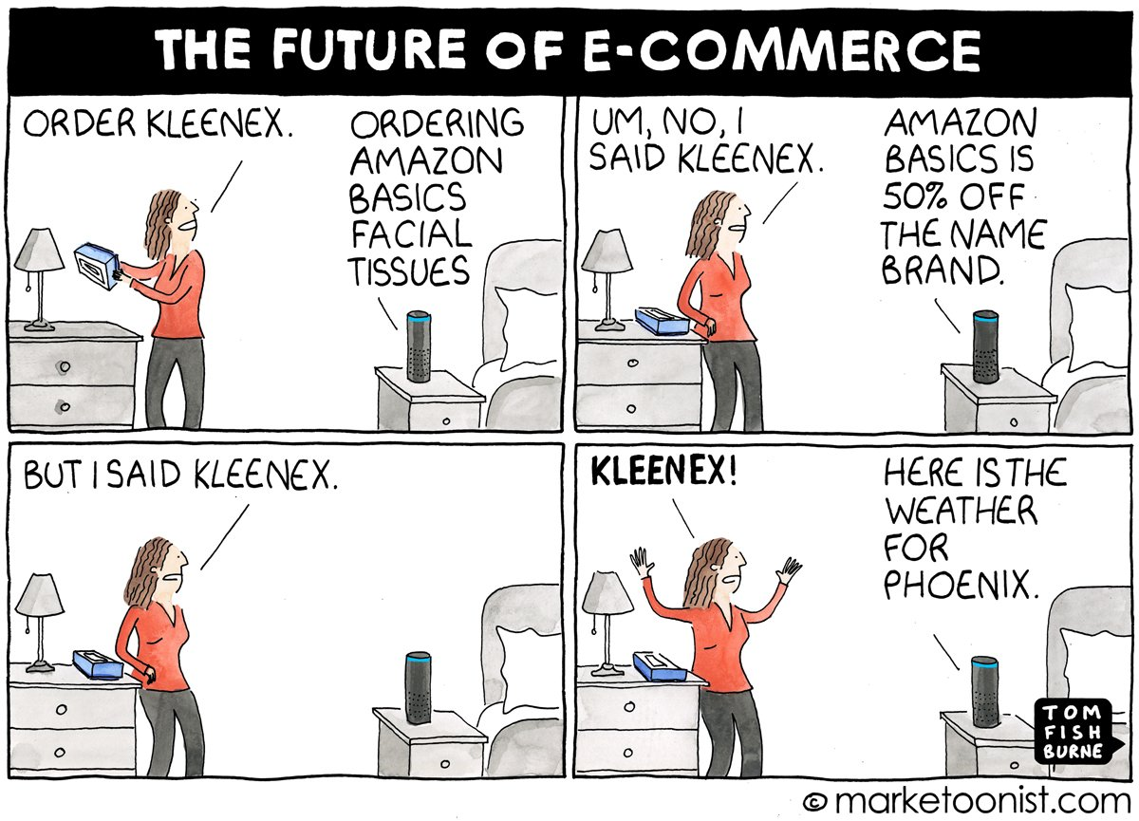
Notes:
And this cartoon might give you a sense for why customers aren’t using their IAs

Slide 17
What happens when people do use assistants for commercial purposes?

Slide 18

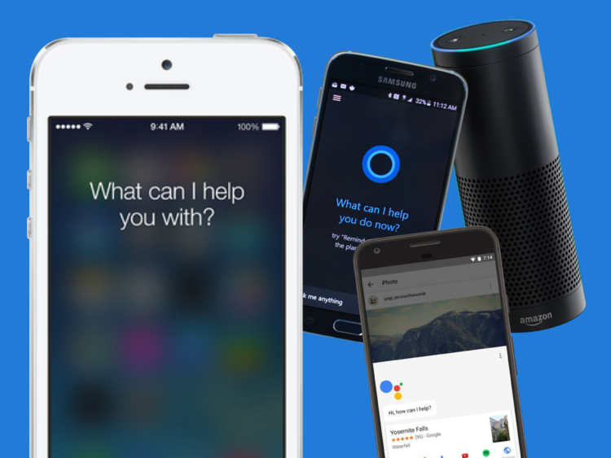

We investigated how well Intelligent Agents can answer commercial questions
Came up with 30 commercial questions for 6 industries
Asked each question to Alexa, Google Assistant, Siri, and Cortana
Tracked and scored each answer we received

Slide 19
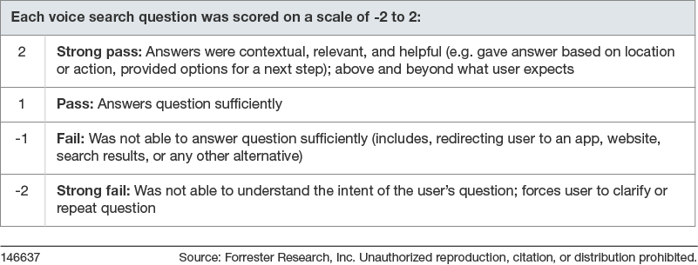
We used a heuristic model to score the IA’s responses

Slide 20
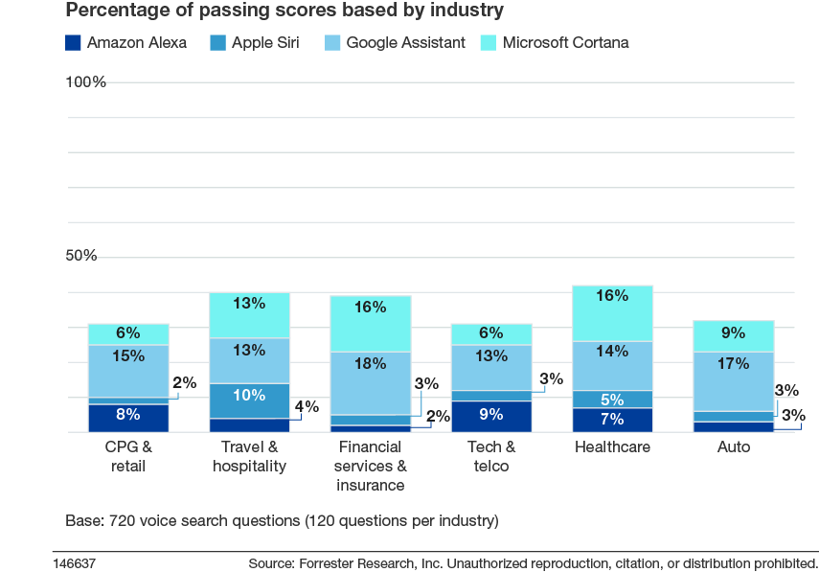
Intelligent Agents failed to answer our questions
35%

Slide 21
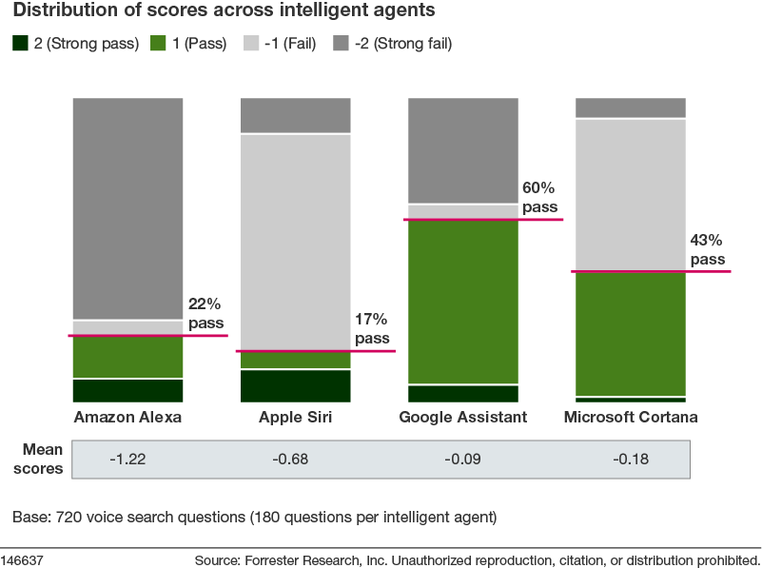
Google Assistant answered the most questions

Slide 22
The IAs had four main shortfalls

Slide 23

IAs struggle to give direct responses

Slide 24
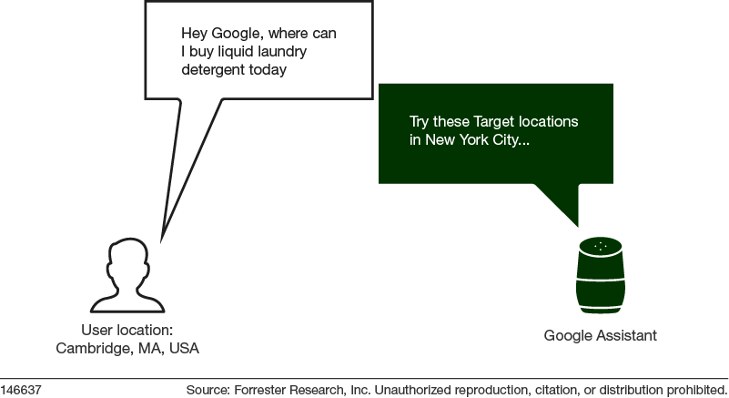
IAs do not always understand user context

Slide 25
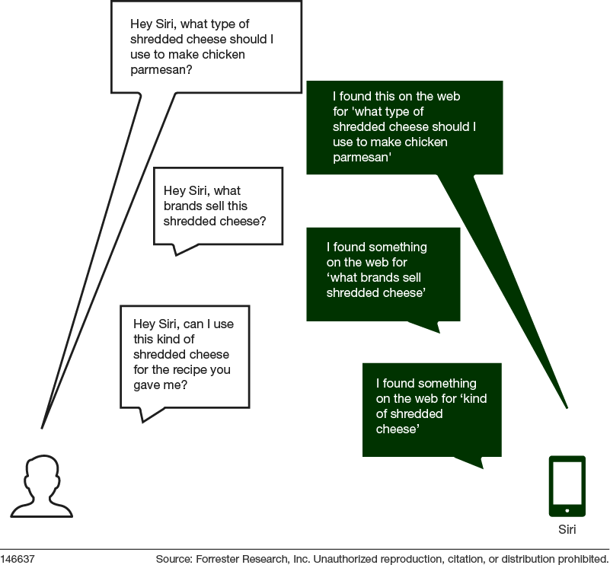
IAs struggle to sustain conversation with users

Slide 26
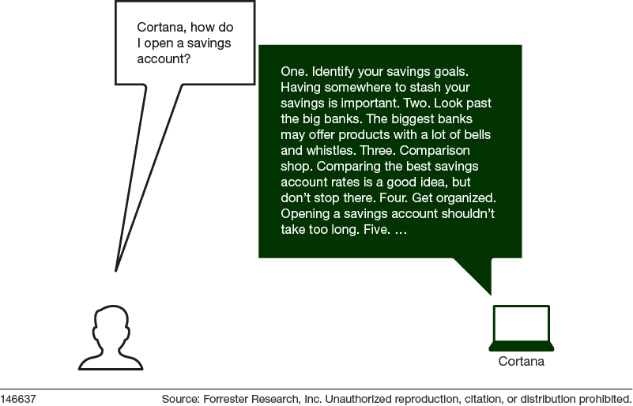
IAs provide poor customer experiences

Slide 27
How are IAs getting their information?

Slide 28
Alexa and Google Assistant have key differences
Alexa
Google Assistant
Deployed on Amazon smart devices
Cannot be used on nearly every phone – can be downloaded but it’s a watered down experience
Database/knowledge graph largely made up of Amazon’s product information
Powered by Bing
Deployed on Android devices and Google smart speakers
Can be used on almost any phone
Database/knowledge graph largely made up of the knowledge graph within Google search
Powered by Google search

Slide 29
Google Assistant credits the publication it got the information from
“There are five from reviews.com: Advil is best for fever, aches, sore throat; Tylenol is runner up; Sudaphede; Benadryl; Mucinex.”
“Which cold medicine is most effective?"

Slide 30
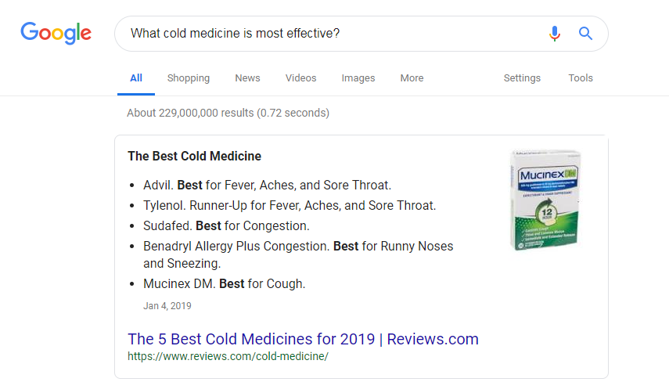
And Google - typically, but not always – pulls from the “Answer Box”

Slide 31
Alexa on the other hand, doesn’t always credit the publication
“Feeling of squeezing or aching chest and arms, belly pain that spreads. If you think you are having a heart attack call for medical help.”
“What are common symptoms of a heart attack?"

Slide 32



Overall, IAs pull content from a variety of sources
Notes:
Search engines are the primary place they pull from today
There are signs that aggregators and other outlets are becoming important – Yelp, TripAdvisor
Alexa is beta testing suggesting skills as answers
Their long-term goal is to build their own “knowledge graphs”

Slide 33
What does the future hold for intelligent agents?

Slide 34

Intelligent agents will mature in three stages
IAs will improve their ability to respond to complex questions. IAs will curate content to a user based on learned habits (location, a person’s daily routine, purchase history, etc.).
IAs will begin to anticipate customers’ needs and wants before they search or ask a question. IAs will suggest or recommend solutions proactively.
IAs will begin to anticipate customers’ needs and wants, consider their affinities and habits, and complete simple purchased on their behalf. IAs will be able to make reoccurring or simple purchase decisions without the user’s explicit consent.
Notes:
We are forecasting that over the next 3 years that the IAs will focus most on determining the most relevant content for a searcher.
They are already doing this to a degree today by taking information and preferential information about customers to serve up the right content. And when they do get a generic search, they are most likely pulling that information from search engines like Google or Bing. And they will continue to utilize existing search engines going forward but they will also likely tap into other apps or skills to serve relevant information over the next 3 years.
In the 3 to 5 year range, we believe the IAs will start to anticipate customers’ needs. So rather than wait for the customer to say something to the agent, the agent will suggest something to the customer.
For instance, with plugs into your calendar and connected dishwasher an IA could suggest you book a flight for your trip in three weeks or that you need to replenish your dishwasher detergent. And the agent could even suggest the brand you should choose based on factors like price, availability, and shipping times. This is already happening on a small scale today: think about how Google Now or your iPhone alert you of when you should leave home to get to work on time based on traffic information.
In the period of 5 years or further, this is when we think the IAs will be able to build on those anticipatory qualities at scale and execute purchases or decisions on behalf of the customer.
For example, a smart fridge hooked up to your Google Home could work together to have your milk restocked every Monday and not re-order when you’re going on vacation. This anticipatory execution on behalf of the customer will reduce the need for people to ask questions or call out demands to their IA, and it will effectively eliminate brands the customer doesn’t like from ever being discovered.

Slide 35
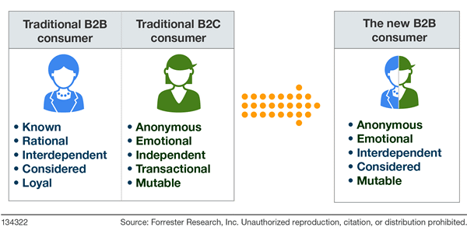
IAs will not just affect B2C companies
Source: Forrester’s “The Birth Of The B2B Consumer” report.

Slide 36
What should you be doing?

Slide 37
You have two options in voice search today
Ensure your content is built with search engine optimization (SEO) in mind to gain visibility in voice search queries
Develop Alexa “Skills” or Google “Actions” that serve simple needs and are based on repetition

Slide 38
Recommendations
Don’t worry about “Skills” or “Actions” right now
Think like a marketer
  The end-user is in control
  Deliver content/information that people are seeking
Ensure you are following SEO best practices in your content
  Structure your content with titles, headlines, bullet bolds, etc.
  Use keywords that your audience uses
  Put content in front of a firewall that will draw users in
  Leverage social media and PR to drive linking to your content

Slide 39

Collin Colburn
+1 212-857-0735
ccolburn@forrester.com

