Slide 1


Trust Is the New Algorithm
Kate Worlock, VP & Lead Analyst
HighWire Press
London Lunch & Learn, June 2019

Slide 2

Agenda
About Outsell
Why are we talking about this now?
Case studies
Recommendations

Slide 3
Why Now?

Slide 4

Paradoxes Drive Distrust
INEQUALITY
TRUST

Slide 5

Trust Disasters and Fake News

Slide 6
Business Implications
I trust news sources
40% UK (↓ from 51%i n 2015)
I am concerned about what is real and what is fake on the internet
70% UK (↑12% on 2018)
INEQUALITY
TRUST
I pay for online news
9% UK, 16% US

Slide 7
The Next Wave
AR/VR
Blockchain
IoT
Knowledge generation
Knowledge graphs
ML/AI
RPA
Video and podcasts

Slide 8
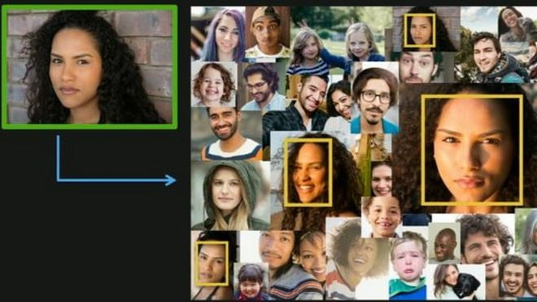
The AI Black Box
AI
Lack of transparency
Inability to provide transparency
Inherent bias
Inability to “uninvent”

Slide 9
Case Studies

Slide 10




+

Slide 11
What Does This Look Like in STM?

Slide 12
Data Lifecycle and Reproducibility
CCC

Slide 13
Essential Actions

Slide 14
Be Ready
Culture, values, and purpose
Core competencies
Transparency
Experiences
Trust Is the New Algorithm
INFORMATION INDUSTRY OUTLOOK 2019

Slide 15
Execute Reliably
Disclose
Diversify talent, thought & culture
Be analytics-driven
Separate product management
Mystery shop the metrics
Improve sales and market share
Rely on partners
Drive innovation
Measure brand
Market and deliver TRUST

Slide 16
Questions?

Slide 17
About Outsell
Outsell is the only research and advisory firm serving information industry CEOs and their teams, and investors in media, tech, data and information. Our solutions are built from the ground up leveraging a unique set of assets: proprietary data, industry leading analysts, world class events, and a thriving and growing peer-to-peer community. Through deep industry relationships, we ensure our clients make great decisions for their businesses on a wide spectrum of topics, including competition and markets, operating and sales performance, M&A and due diligence, and critical trends. We stand by our work 100% and guarantee results. That’s how fanatical we are about our clients’ success.
www.outsellinc.com
info@outsellinc.com
Burlingame, CA · USA
+1 650-342-6060
London · United Kingdom
+44 (0)20 8090 6590
The information, analysis, and opinions (the “Content”) contained herein are based on the qualitative and quantitative research methods of Outsell, Inc. and its staff’s extensive professional expertise in the industry. Outsell has used its best efforts and judgment in the compilation and presentation of the Content and to ensure to the best of its ability that the Content is accurate as of the date published. However, the industry information covered by this report is subject to rapid change. Outsell makes no representations or warranties, express or implied, concerning or relating to the accuracy of the Content in this report and Outsell assumes no liability related to claims concerning the Content of this report.

